Slide 1
Data-Driven Health Insurance Upsell with Machine Learning
​

Slide 2
MEET OUR TEAM
Raghavendra
SURYA MANJRI
Gowtham Reddy
Hemanth
​
Team Leader
Team Member
Team Member
Team Member

Slide 3

BUSINESS objective
A financial service provider has introduced a new policy and aims to upsell health insurance to their existing customers by predicting customer interest based on demographics and policy information.

Slide 4
Proposed Solution
This project will have a machine learning model that can predict customers interested in health insurance. It'll help the team to select the best customers that may be interested in health insurance.

Slide 5

CRISP DM METHODOLOGY

Slide 6


BUSINESS UNDERSTANDING
To properly analyze the data and pose business-related
queries about it, we should possess a fundamental
understanding of business within our domain.
For example, our question could be: In what ways will the
company customize their health insurance upselling
approach based on customer demographics?
What particular information about the consumer base
or data points will the company utilize to forecast interest
in the new health insurance policy?

Slide 7

DATA UNDERSTANDING
During this phase, we identified, collected, and analyzed the datasets that helped us achieve the goals of the project.
The dataset was acquired from Kaggle.
01
02
AGE, PROPOSED PLAN, HEALTH ISSUES, and DECISION were the key values that were required to accomplish the project.

Slide 8


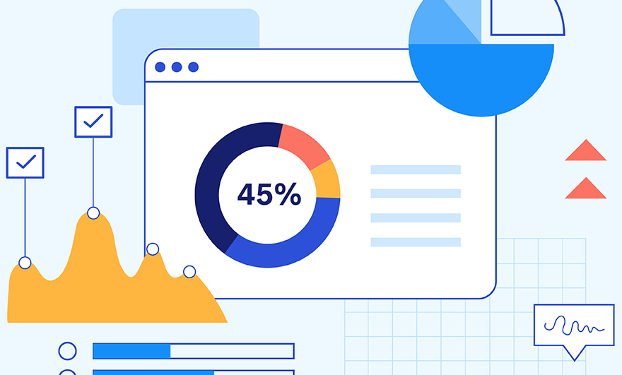







project plan
DATA
CLEANING
DATA
MODELING
DATA
VISUALIZATION
DEPLOYMENT

Slide 9

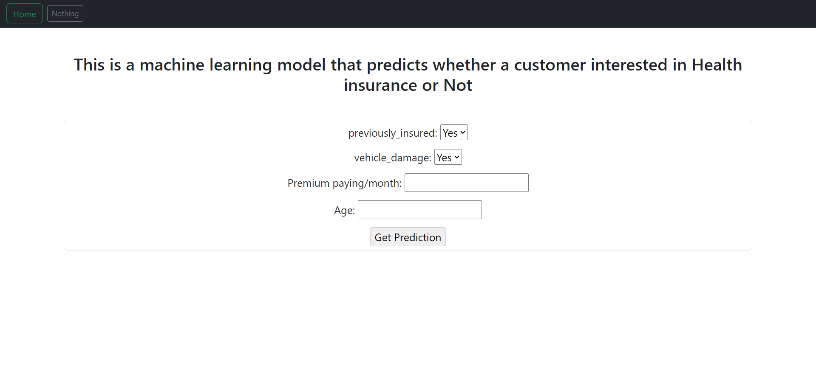
DEPLOYMENT
Deployed the application on Digital Ocean.
Open source app framework for machine learning and Data Science.
The application code has been hosted on GitHub respiratory.
SCAN THIS QR TO OPEN MODEL

Slide 10
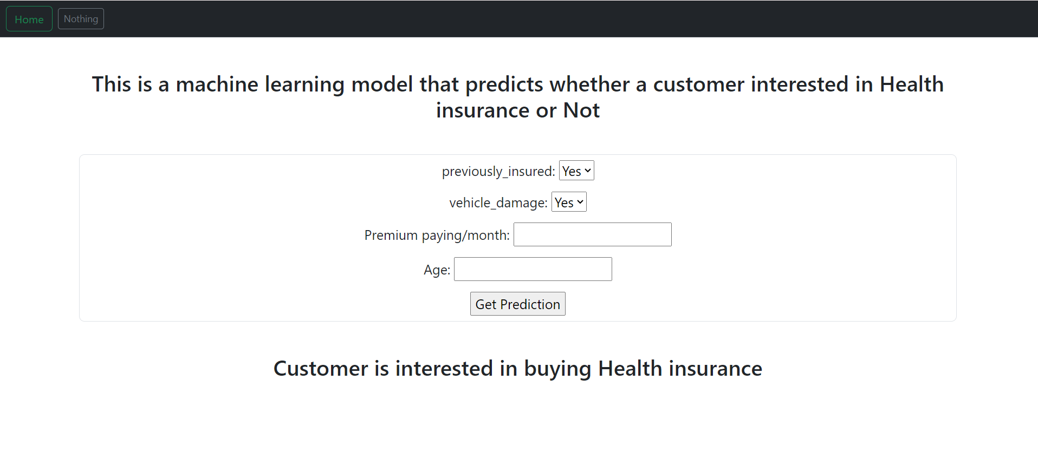
MODEL OUTPUT

Slide 11

FUTURE APPROACH
Customer Satisfaction and Feedback
• Analyze customer feedback, complaints, and satisfaction surveys to understand policyholders' experiences. Which will help the company to bring the new customers to policy.

Slide 12
THANK YOU

